Slide 1
Assembly Language
The Foundation of Computing

Slide 2
History & Purpose
Born: 1940s-50s
One step above machine code
Direct hardware control

Slide 3
Design Characteristics
CPU-specific instructions
Maximum performance
Minimal abstraction

Slide 4
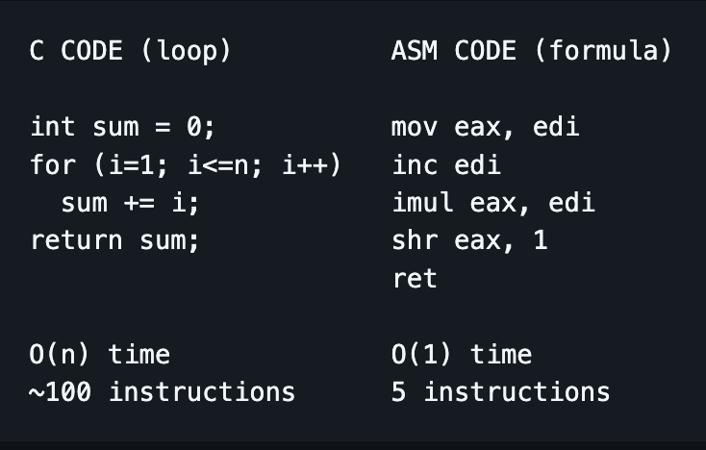
C versus Assembly

Slide 5
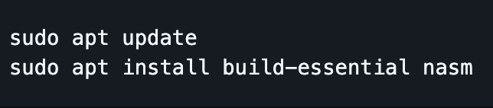
Install Dependencies

Slide 6
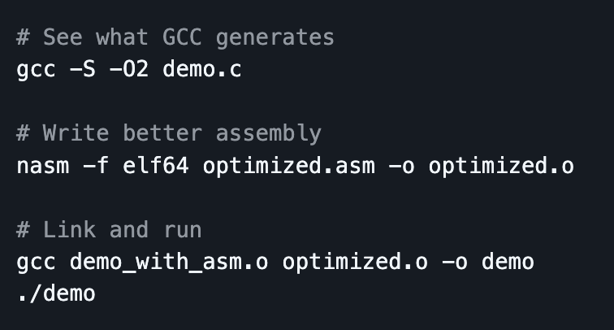
https://github.com/jwm-dev/asm-presentation/tree/main

Slide 7
Ecosystem
Assemblers: NASM, GAS, MASM
Debuggers: GBD, LLDB
Use cases: kernels, drivers, general optimization

Slide 8
Stack Overflow Survey
“Most intimidating” language
Used by 5.7% of developers
Respected but rarely preferred

Slide 9
Takeaway
Assembly: View your hardware and software as a single artifact rather than as discrete systems!

